Slide 1
SRCS-SOMALILAND PROJECTS/PROGRAMMES In 2023
Mission
Vision
Core Values
RC/RC Principles
Resilient communities empowered and enabled to deal with the causes of suffering and respond efficiently and effectively to the needs of vulnerable people
To alleviate human suffering by working with communities, local authorities and other partners to provide the needed humanitarian services to the vulnerable people in accordance with the Fundamental Principles of the Red Cross Red Crescent Movement and Humanitarian Values
Integrity Commitment Transparency Accountability Value for People Teamwork
Humanity Neutrality Voluntary Service Universality Impartiality Independence Unity
Presented By
Ahmed Abdi Bakal
SRCS-Somaliland Executive Director
General Assembly Meeting
04-06-204

Slide 2
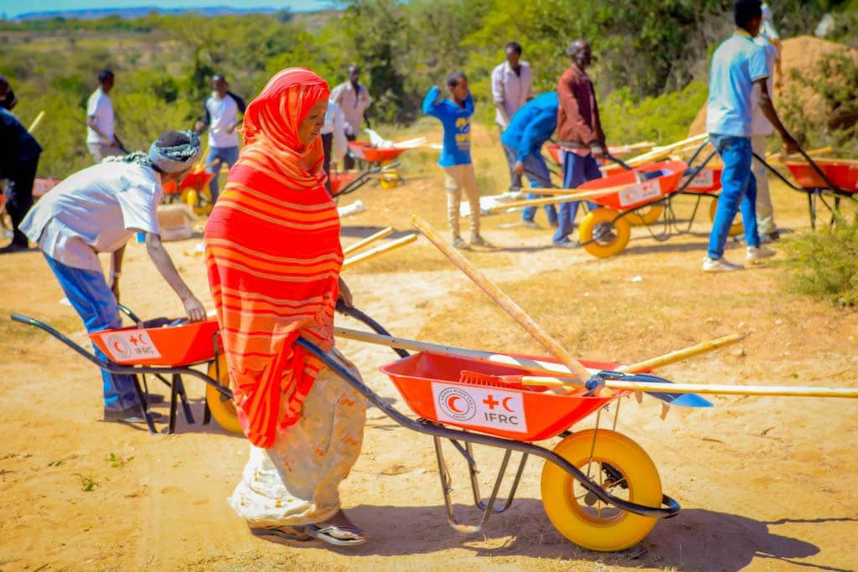
Contents...
1
Overview of SRCS- Somaliland
2
List of Projects and the Supported Partner
3
Programme Project Update ( Year In Numbers)
4
National Society Development (NSD)
5
Challenges
6
Recommendations

Slide 3
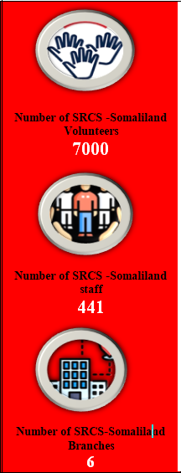
Overview of SRCS-Somaliland

Slide 4
List of Active Programmes/ Projects and the Supported Partner in 2023
# | Programme/Project Name | Supported Partner
1 | Primary Health Care | FRC, IFRC & Icelandic
2 | Community Health | Norcross & CRC
3 | ICCM RESULT TWO OF ECHO-PP | Norwegian through IFRC
4 | ECHO-PP | EUPNS:- Finnish RC, Norcross, and DRC. IFRC.
5 | Emergency Appeal | IFRC
6 | Integrated Community Resilience | Netherlands government through IFRC
7 | EL-NINO floods DREF | IFRC
8 | BMZ project | GRC
9 | Global Project Phase two | GRC
10 | Forecast Based Financing (FbF) | GRC
11 | SHERC project | CRC, IceRC
12 | Restoring Family Links (RFL) | ICRC

Slide 5
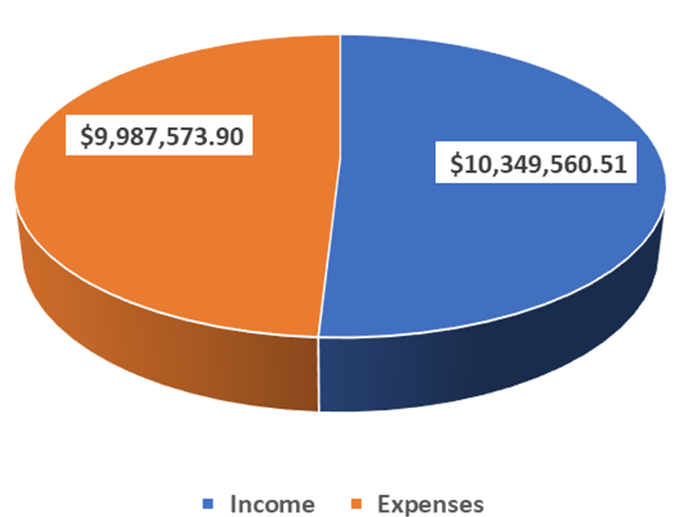
Continue…
# | Programme/Project Name | Supported Partner
13 | GOJ project | Japanese Government through IFRC
14 | First Aid and Pre-Hospital Care | ICRC
15 | Nutrition | UNICEF
16 | Integrated Community Resilience Project (SPA) | DRC
Total Income and Expense in 2023

Slide 6
Total Income and Expense Per Programme/Project

Slide 7
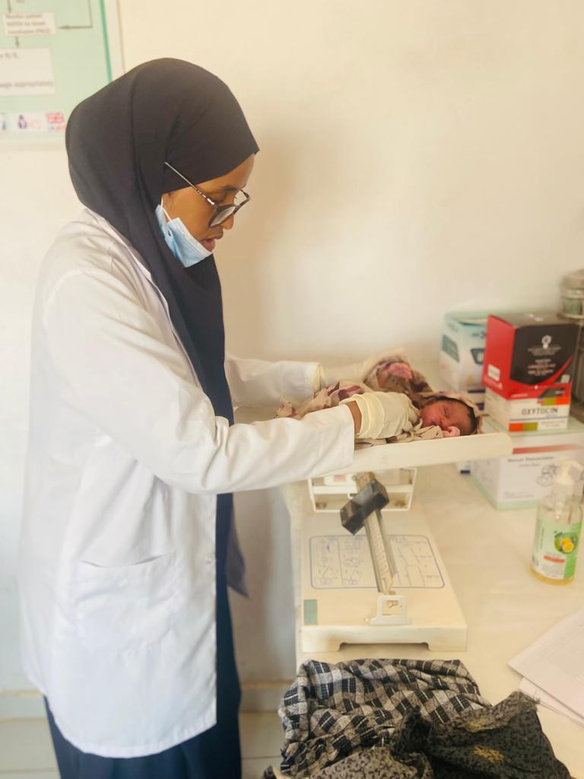
Programme Project Update Health Department ( Year In Numbers)
Integrated Health Care Programme
The programme provides integrated health care services to all communities in Somaliland.
In 2023, the most common disease detected and caused morbidity in all 48 SRCS-Somaliland Health facilities (Mobile and Fixed) were Acute Respiratory diseases (ARI) 21%, Skin diseases 9%, Eye infection 6%, Diarrhea7% and Penuamena 4%.
A total of 465,980 cases (241,337 female and 224,643 male) were treated in health facilities for various health conditions, of these total 76% of them were women and children.
Health Education: SRCS-Somaliland health facilities provide health promotion to 251,521 people (138337 females and 113184 males).
HIV sessions: In 2023, the clinics tested 624 cases and detected 2 positive cases. See the table below.
Non-Communicable disease (NCD): Total of 980 people were treated in SRCS- health clinics of these 523 were female while 457 were Male

Slide 8
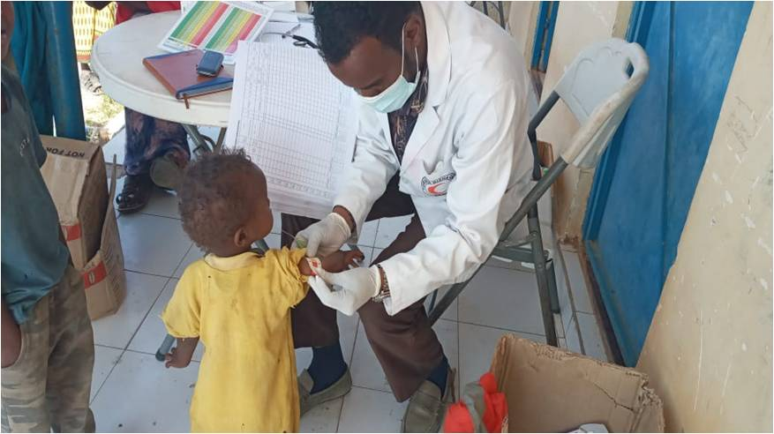
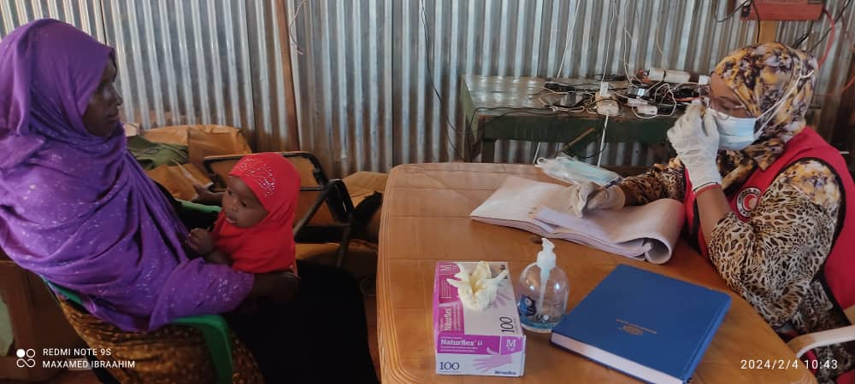
Continue…
Expanded Programme for Immunization (EPI): From January to December 2023 SRCS-Somaliland health facilities provide immunization on 29,042 under one year children with 3 doses of the (Penta 3), a combined vaccine for diphtheria, tetanus, and pertussis (whooping cough), while 34,664 children under five received measles vaccination, 26,660 children under the age of one years that received the BCG vaccine.
To prevent women of reproductive age against Tetanus SRCS-Somaliland health facilities provides vaccination to 55,806 of women of childbearing age received the Tetanus-Diphtheria (Td) vaccine Out of this total, 40,096 were pregnant women and received at least two doses of the tetanus diphtheria vaccination.
Safe Motherhood: In 2023, 49,883 women received Ante Natal Care (ANC) services. Seventy percent of them (34235) made at least 4 Ante Natal Care (ANC) visits.
A total of 46,540 pregnant women received Multi Micro-Nutrient (MMNwhile 27,729 received Iron and Folate supplements to prevent or address anaemia.
Mother Deliveries Assisted : In 2023, total of 15,541 deliveries were assisted in the target health facilities, by skilled midwives.
Children Immunization
Pregnant Women Counselling

Slide 9
Continue…
Nutrition: In 2023, the nutrition programme screened a total of 109,076 children under 5 years of age to monitor their growth. Out of that number, 21,306 (19.5%) were classified as having Moderate Acute Malnutrition (MAM) and 4,969 (4.5%) with severe acute malnutrition (SAM) which brings the GAM rate to 24%.In addition to that, 37 children were identified as having oedema.
Infant young child feeding promotions (IYCF): In 2023, total of 48,512 Pregnant and lactating mothers received individual sessions on breastfeeding, supplementary feeding from age 6-23 months, feeding the sick child, and weaning practices.
Group promotion sessions attracted 64,412 (35,426 female &28,985 male) participants.
SRCS-Somaliland Nutrition with collaboration of WFP provided, 18,183 children received Vitamin A. Further 9,062 were given zinc as a complimentary treatment for diarrhoea, while 18,736 were deformed to prevent intestinal worm infestation.
In 2023 SRCS-Somaliland identified total of 2143 Alerts from the NYSS platform.
Children Immunization
Pregnant Women Counselling

Slide 10
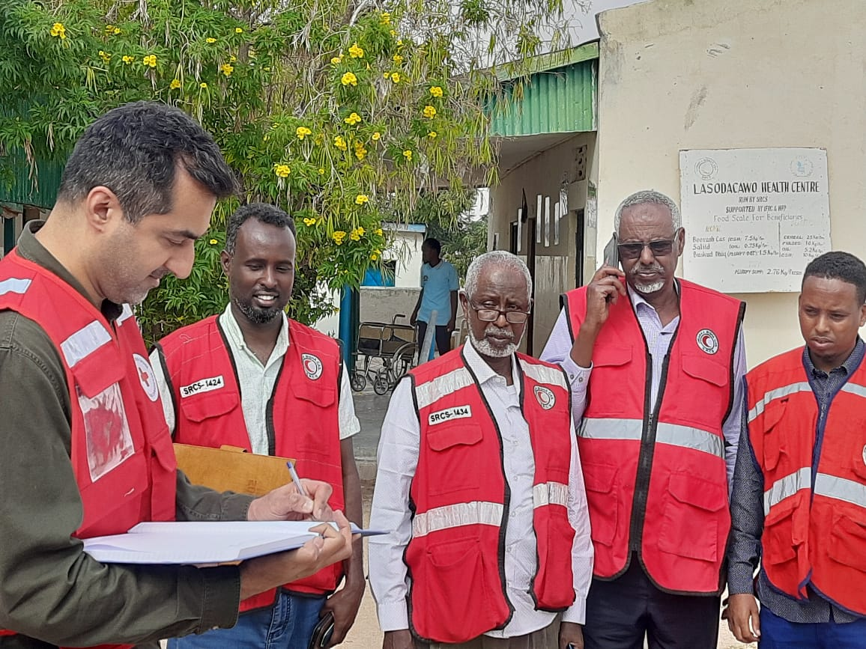
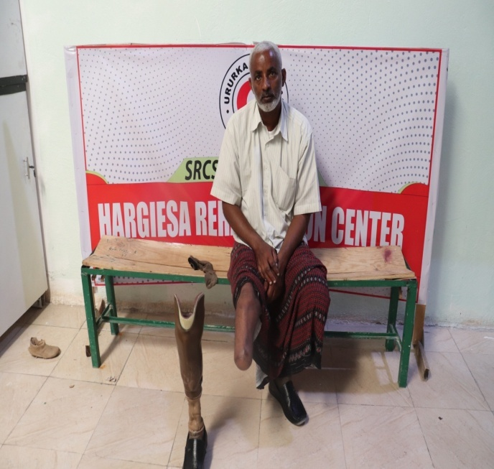
Continue…
Community based Surveillance “CBS”: In 2023, the Community based volunteer’s (CBS) reported total of 27,647 reports from the six regions out of these 4,034 health risks
Integrated Community Case Management (ICCM): In 2023, the ICCM programmer treated 3,699 children were treated on pneumonia and diarrhea, pneumonia cases were 2322 while diarrhea was 2377.
First Aid and Pre-hospital Care : In 2023 2434 patient were assisted by the Lasanod ambulance
Rehabilitation Center: In 2023 The rehabilitation center provide services to 2620 individuals through it various departments such as Orthopaedic department, Physiotherapy department.

Slide 11
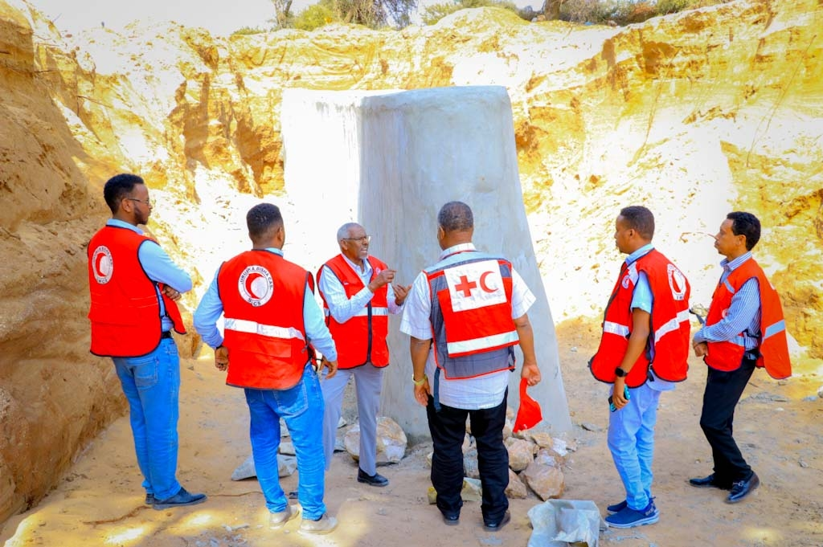
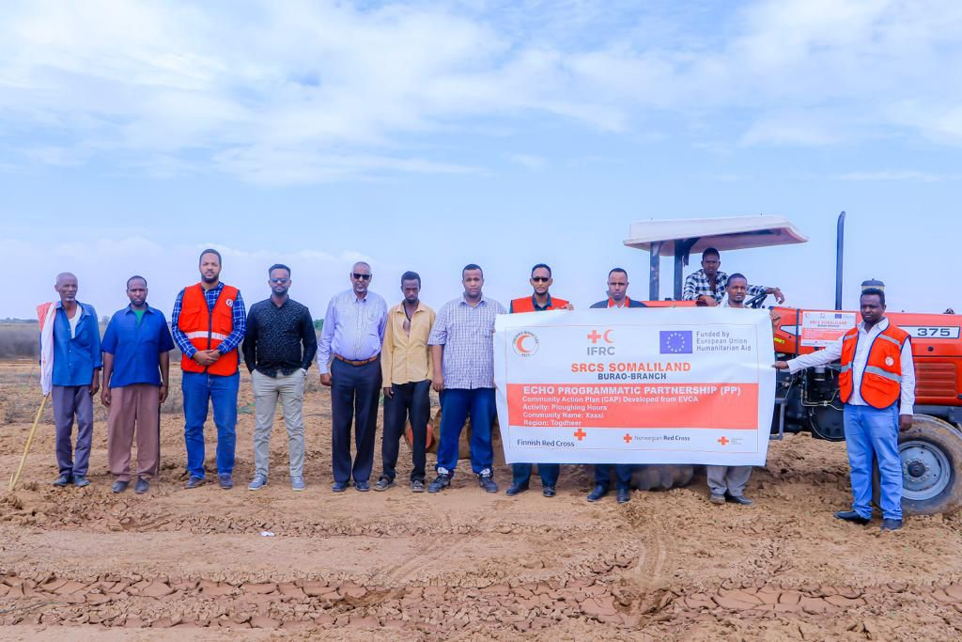
Disaster Risk Management Department (Year in Numbers)
Disaster Risk Management department (DRM) have thematic or intervention areas of WASH, CVA, Disaster preparedness, Wash/Shelter NFIs, Livelihood, Early warning Early Action, Emergency react, environmental protection PGI, and CEA.
Cash Assistance: In 2023, The SRCS-Somaliland provided cash assistance to 6702 house hold (40, 212 individual) in all Somaliland regions.
WASH: 26 berkads, and 4 shollow wells
Livelihood: 515 House holds ( 3,090 people were provided ploughing Hours
WASH/shelter NFIs : 41,700 HH were provided water and Shelter NFIs

Slide 12
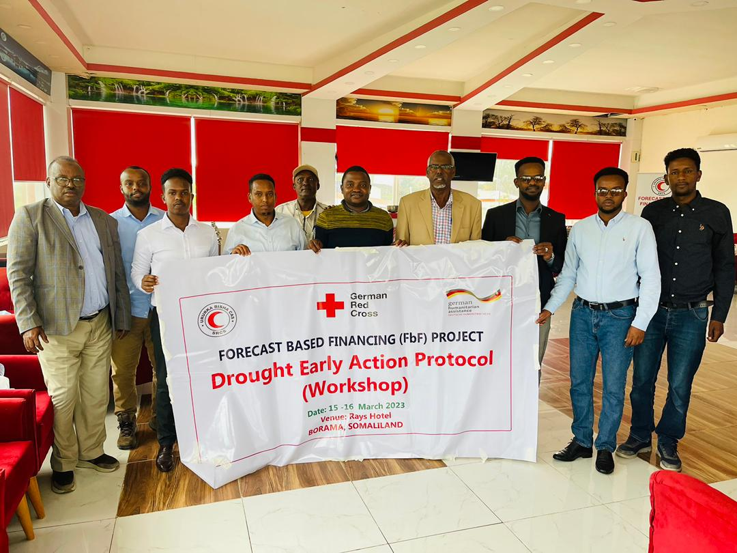
Continue…
Environmental Protection : In 2023 SRCS-Somaliland, has planted 3,300 tree seedlings under the Emergency Appeal fund, to mitigate climate change impact in Somaliland.
Early warning Early Action : In 2023 SRCS-Somaliland reached 38,270 people through FM radio messages and provides early warning information.
Under the El-Niño DREF 80 volunteers (50 males and 30 females) were trained on early warning and evacuation during emergencies to reduce the risk of flash flood
Development of Earl Action Protocol (EAP fro Drought)
Establishment of the Somaliland Anticipatory Action Technical Working Group.

Slide 13
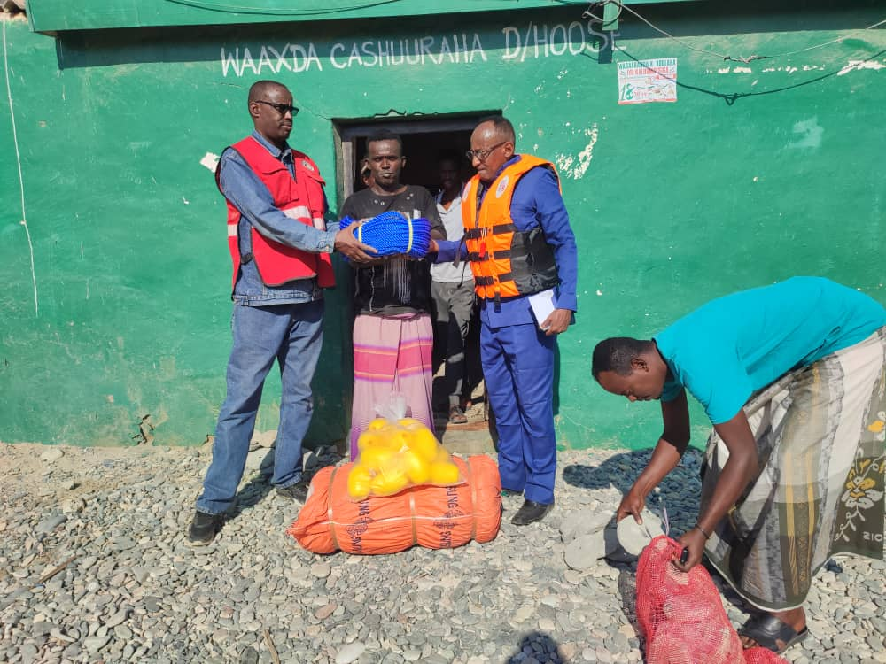
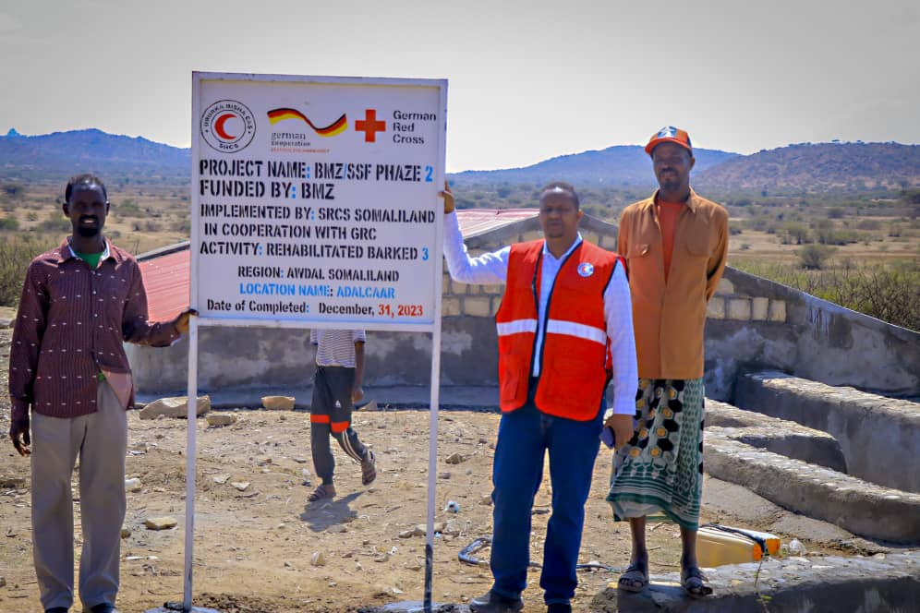
Resilience Department
Since 2003 the resilience program implemented various interventions through the six regions of Somaliland these are: - WASH, livelihood, Cash voucher assistance and community capacity building through various trainings these are disaster risk reduction, Good agronomic practices, and Early Warning Early Action.
In 2023, the Resilience department rehabilitated 9 water points (Barked)
40 farmer were trained on GAP (Good Agricultural practices)
In 2023 SRCS-Somaliland resilience department provide cash assistance to 1370 HH (8,220 people) which are the most vulnerable communities in Somaliland.

Slide 14
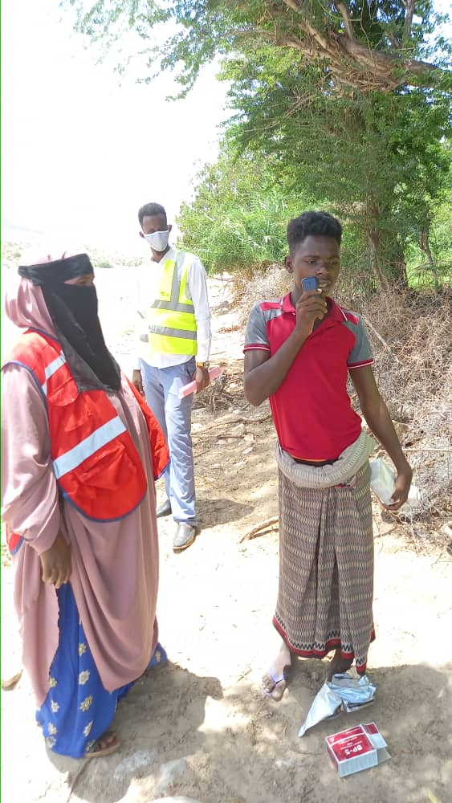
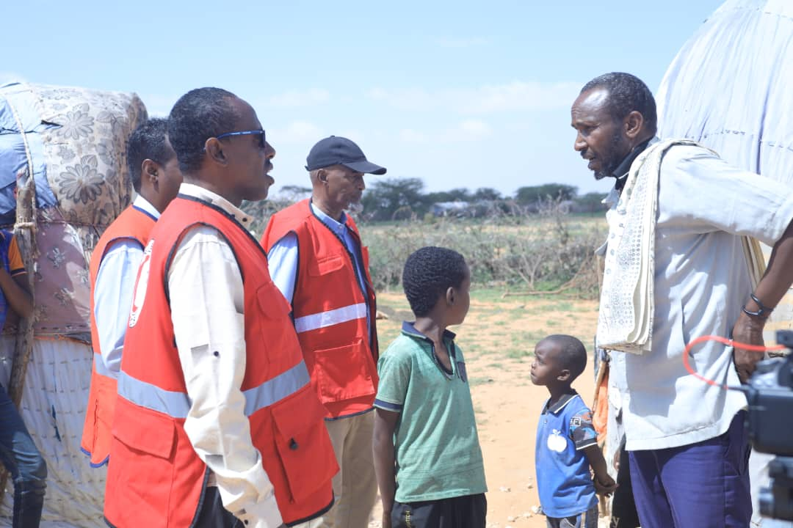
RFL & Communication
Phone call services: Total 6950 people were provided phone call services these are migrants from Yeman, IDPs, and Somali returnees from yeman.
Tracing Cases: Total of tracing solves was 144 cases.
RCMS Red Cross/ Crescent massages:
in 2023 Total of 41,986 massages was exchanges.
In 2023, Communication department reached 17,710 audiences through operational communication sessions such as meetings and trainings in SRCS Somaliland branches.

Slide 15
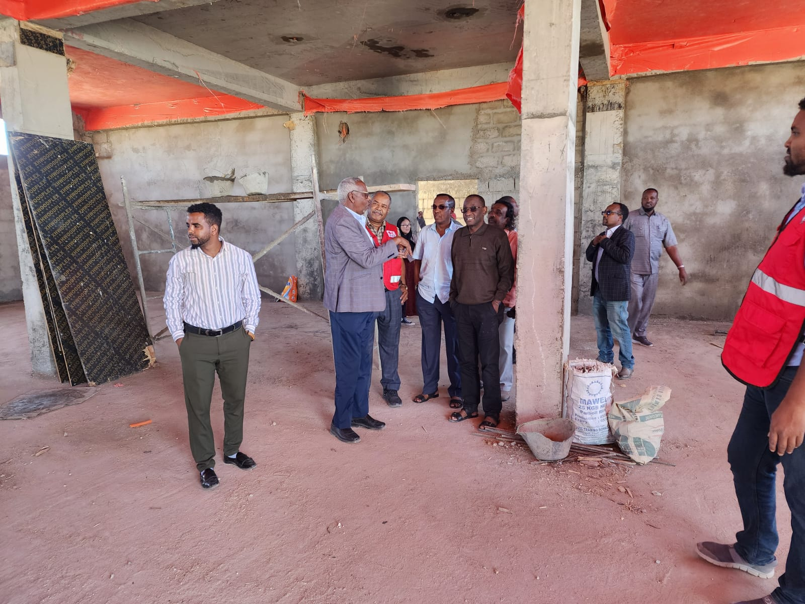
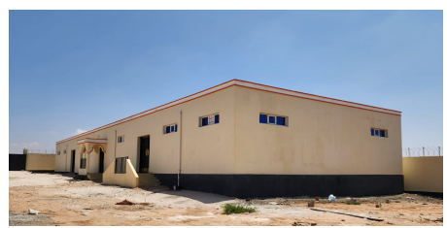
National Society Development (NSD)
National Society Development (NSD) Initiative contributed towards building a strong and Resilient National Society.
The Overall goal of the NSD initiative is to revise, develop and strengthen SRCS organizational systems and procedures for SRCS to be able to deliver timely and effective response to people in need and to address issues of financial sustainability, accountability and compliance
Number of partners fund this initiative including ICRC, IFRC, British Red Cross, Canadian Red Cross and Icelandic Red Cross.
Infrastructure development:-
Construction of the fence wall for the new SRCS Coordination compound in Hargeisa (90mx48m).
Construction of two warehouses (22mx16m).
Construction of the youth clubs of volunteers in Hargeisa and Burao branchf disabled friendly toilet.  Security room

Slide 16
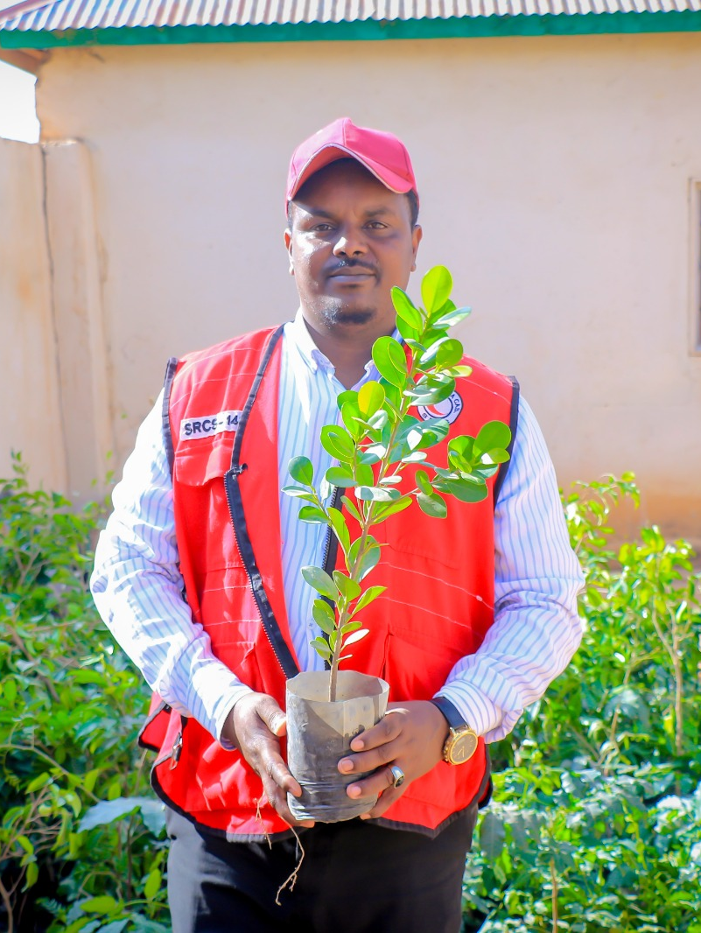
Tree Plantation and Care Initiatives
SRCS is part of the four IFRC Pan-African initiatives including Tree plantation and Care initiatives:
Tree planting and care will have positive effects on climate change mitigation. SRCS Somaliland took part in initiatives led by of Ministry of Environment and Climate Change in Somaliland which planted this year more than 400,000 tree seedlings.
For the goal of adapting, mitigating the risks of climate change, combat desertification, restoring degraded land, and increasing the knowledge and awareness of the community on the importance of tree planting and care

Slide 17
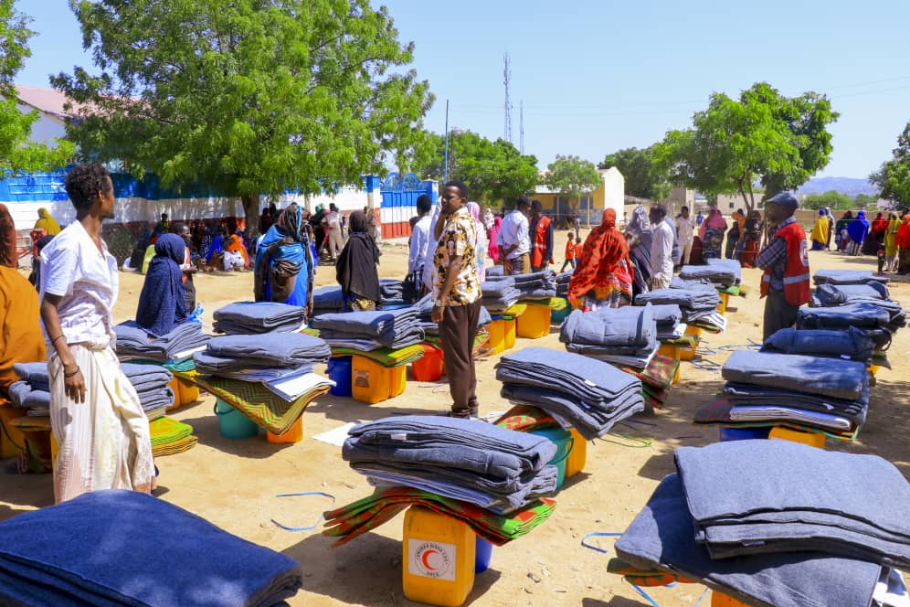
National Society Development (NSD)
Red Ready Approach:
To improve the SRCS efficiency, boos the preparedness for effective response (PER), of the national society to protracted disasters, the SRCS Hargeisa coordination office prioritized Red Ready Initiatives by procuring key essential Shelter and WASH NFI kits that are in the SRCS 6 Branch warehouse to respond to disasters. This will increase the national society’s capacity to respond to the disasters.

Slide 18
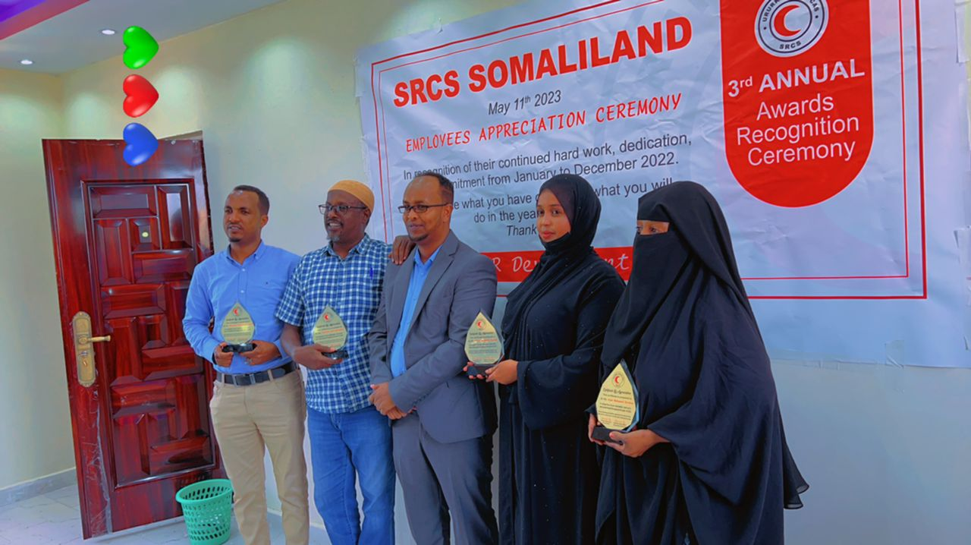
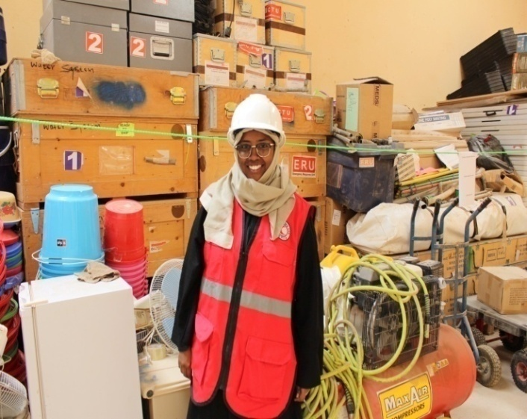
Continue…
HR development:- Dissemination of HR policy throughout the SRCS Somaliland branches and reaching 96 employees during July 2023.
Conducted health and safety assessment focusing on workplace environment and safety disabled friendly toilet Security room
NSD has supported annual performance appraisal ceremonies throughout SRCS Somaliland branches.
Finance development: Asset management workshop was held in Nairobi on June and November with the participation of finance, procurement and HR managers. Within these workshops the participants have formulated SRCS asset management policy as this will improve the proper management organization’s infrastructure and assets.
Youth development: SRCS Somaliland Youth and Volunteer manager has made two weeks’ exposure visit to the Kenyan Red Cross in Nairobi so as to observe and learn from his counterpart at the KRC.

Slide 19
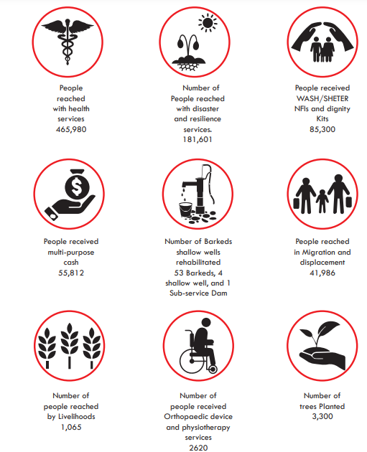
SRCS-Somaliland 2023 Milestones

Slide 20
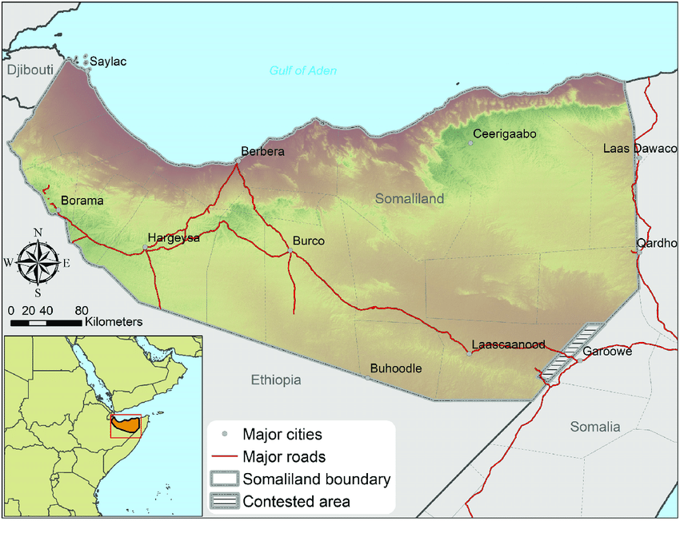
Country Update
Somaliland Presidential and National Party elections, scheduled for November 13, 2024
AWD/Cholera outbreak in Somaliland especially on the border between Ethiopia Awdal and Maroodi-jeh regions. Additionally to that, the MOHD reported that cholera is expanding and there are new hotspots in the Togdheer and Sool regions.
The SRCS-Somaliland NYSS platform detected the outbreak of measles in Togdheer, Sanaag, M,jeex, and Sool regions.
The Gu’ rainy season did not reach all over the country, however, the eastern regions received more rains than the western regions

Slide 21
Challenges, Gaps and Needs
Limited resources, funding income, and increasing needs have been the most significant impediments to implementation. In addition, the compounding impacts of the El Nino flash floods, recurrent drought, desert locusts, outbreak of AWD/Cholera have further strained the resources and increased the population in need in Somaliland
Need for critical support in water needs such rehabilitation of berkeds/shallow wells/Boreholes as there is widespread and increasing critical water shortage and limited government financial capacity/fund

Slide 22
Challenges, Gaps and Needs
Shifting from the emergency project to the Resilience Development program
SRCS-Somaliland requires comprehensive support for its National Society Development initiatives to enhance its resilience and preparedness for various shocks and disasters.
SRCS-Somaliland’s capacity to respond to shocks is limited

Slide 23
Recommendations
Support of National Society Development (NSD)
As the national elections are scheduled for November, SRCS-Somaliland advises its partners to prepare and activate the El Nino Disaster Relief Emergency Fund (DREF). Given the potential for increased instability and logistical challenges during the election period, it is crucial to ensure that all necessary measures are in place to respond effectively to any crises that may arise. Such as:-
Focus on long-term development programs
SRCS-Somaliland recommends that partners implement contingency plans to maintain operational continuity and ensure the safety and security of staff and volunteers.

